Slide 1
Unit 5 Department of Computer Science & Eng.

Slide 2
Unit 5
Undecidability
Properties of Recursive and Recursively enumerable languages
Introduction to Computational Complexity
Decidability vs Undecidability
Examples of Undecidable Problem
Rice Theorem
Post Correspondence Problem
Time and Space complexity of TMs
Complexity classes: Class P, Class NP
NP hardness
NP Completeness
Undecidable problems about Turing Machine- Post’s Correspondence Problem

Slide 3
Undecidability

Slide 4
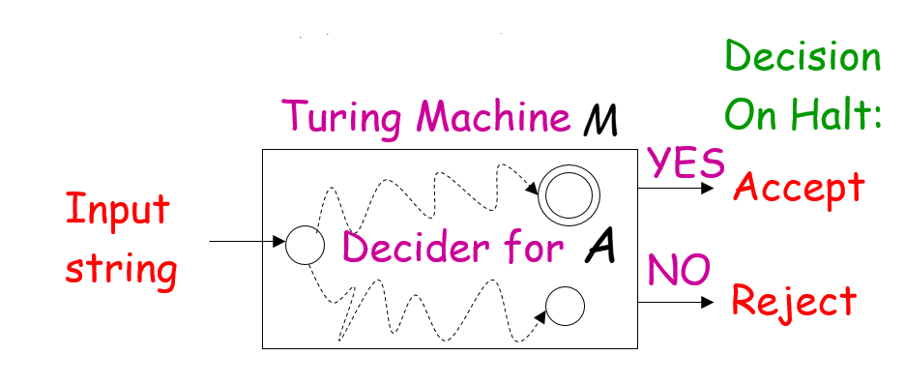
Decidable Languages
A language is decidable,
if there is a Turing machine (decider)
that accepts the language and
halts on every input string

Slide 5
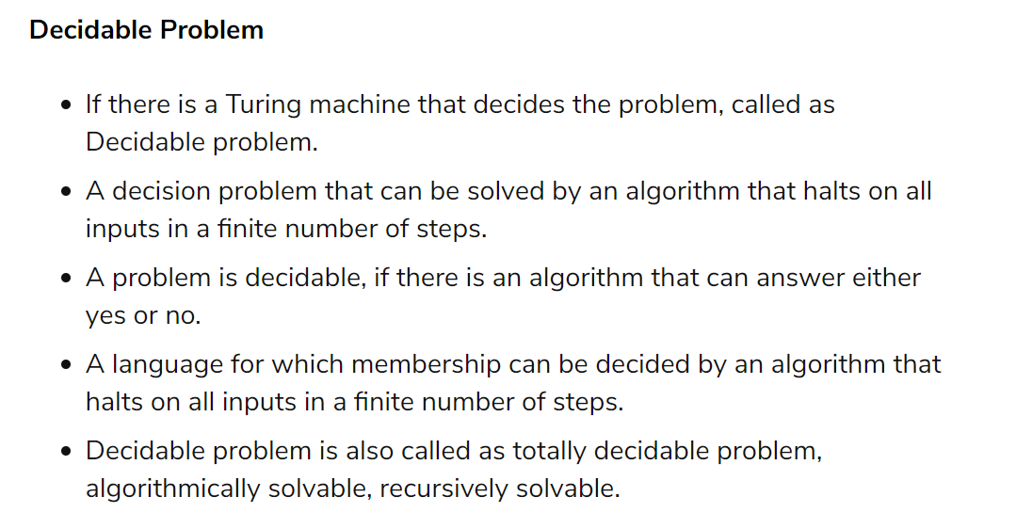

Slide 6
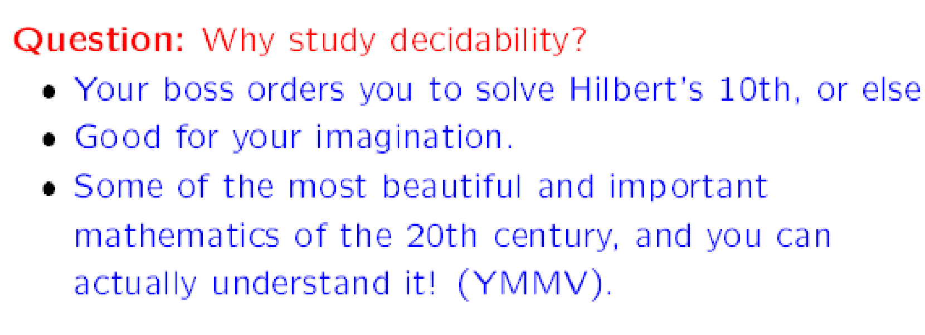
Decidability

Slide 7
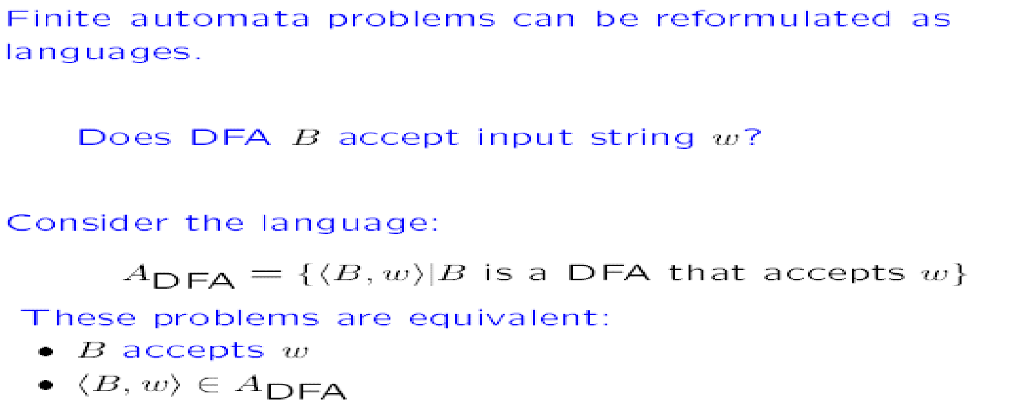
Example

Slide 8
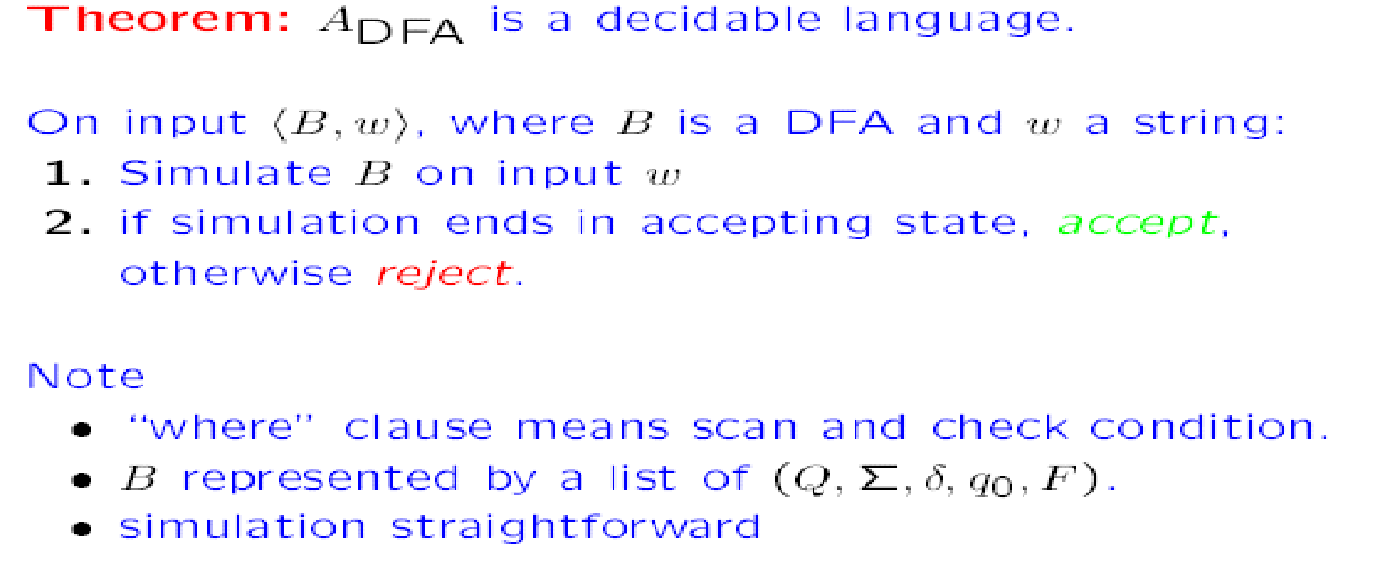
Theorem

Slide 9
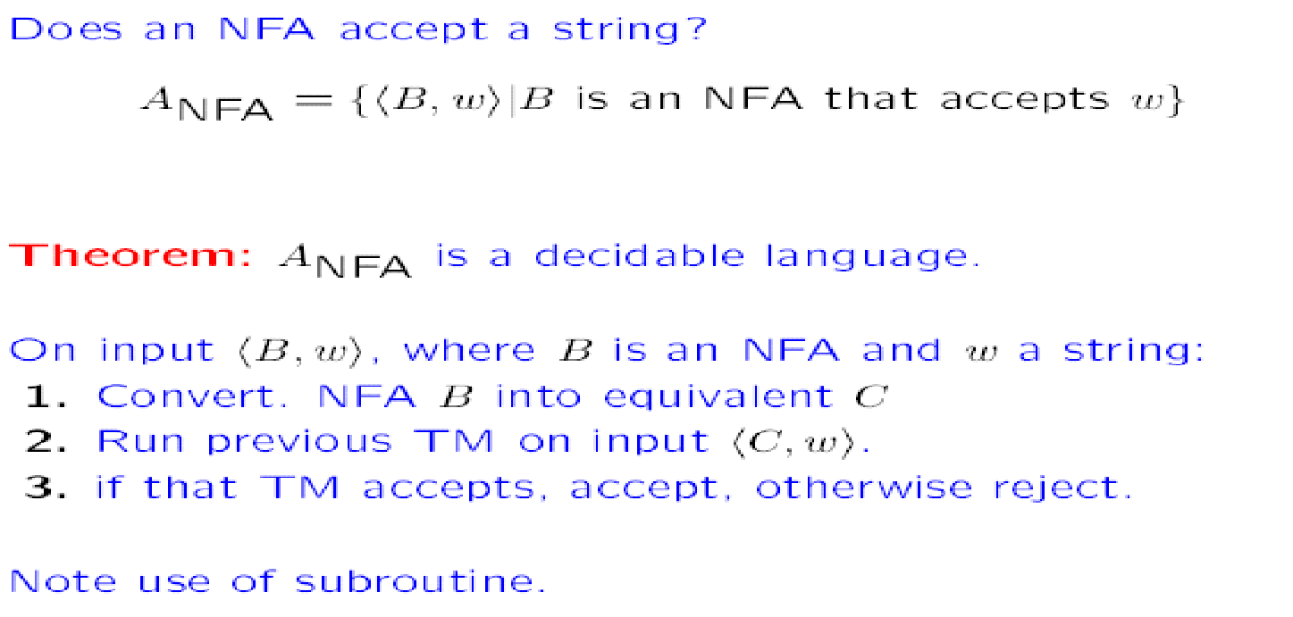
Theorem

Slide 10
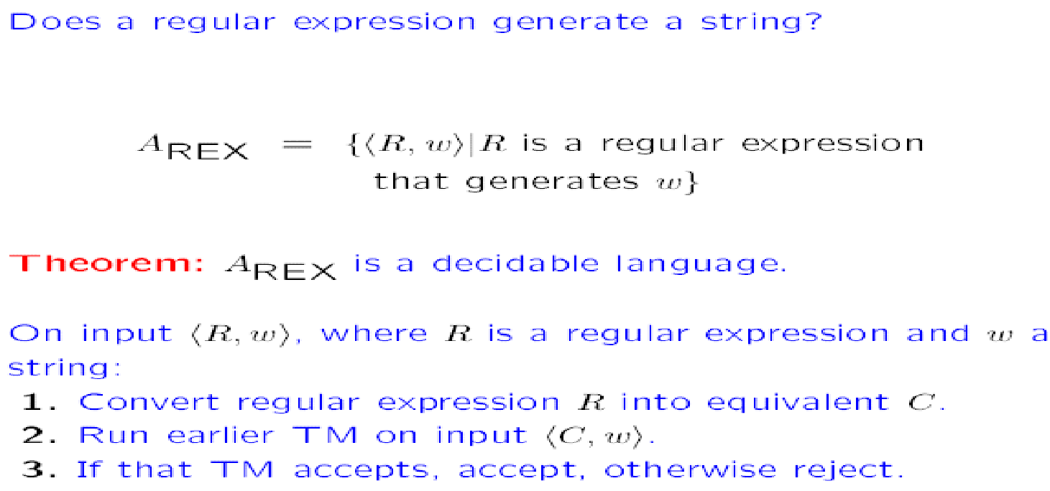
Theorem

Slide 11
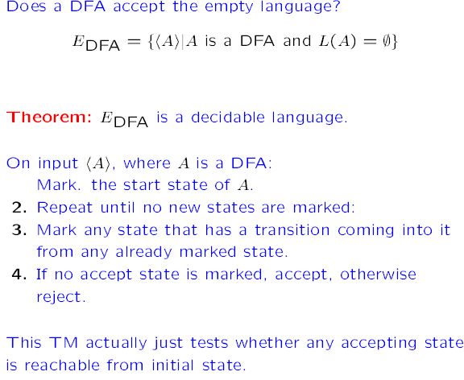
Theorem

Slide 12
Undecidable Languages
undecidable language = not decidable language
There is no decider:
there is no Turing Machine which accepts the language and makes a decision (halts) for every input string
(machine may make decision for some input strings)
there is no Turing Machine (Algorithm) that gives an answer (yes or no) for every input instance
(answer may be given for some input instances)

Slide 13
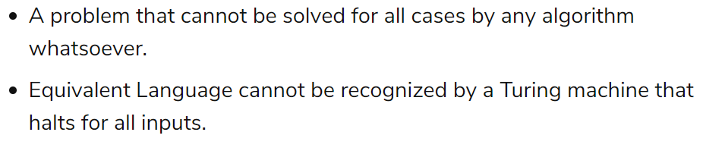
Undecidable problem

Slide 14
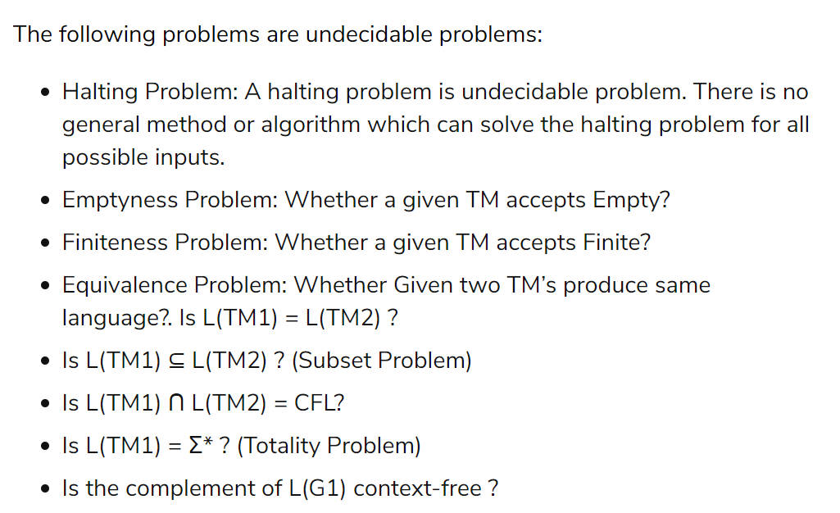

Slide 15
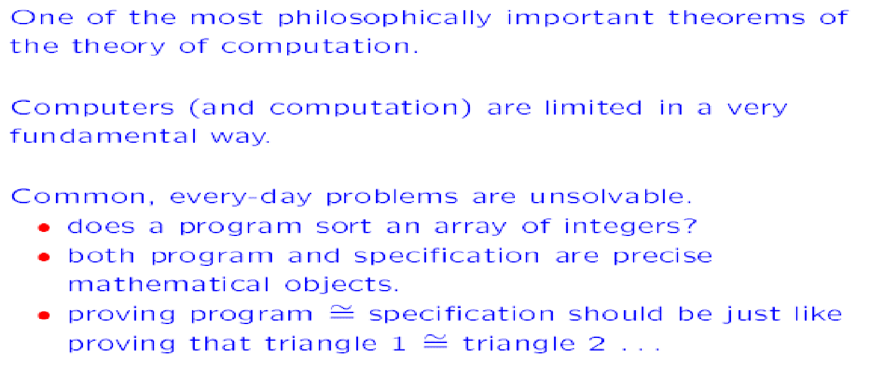
Halting Problem

Slide 16
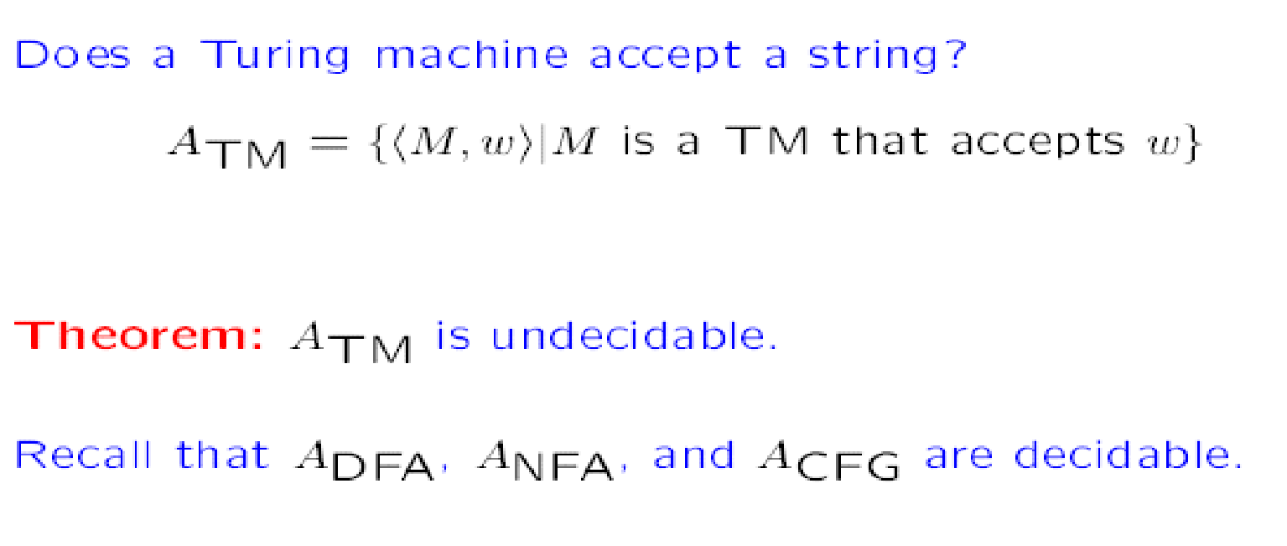

Slide 17
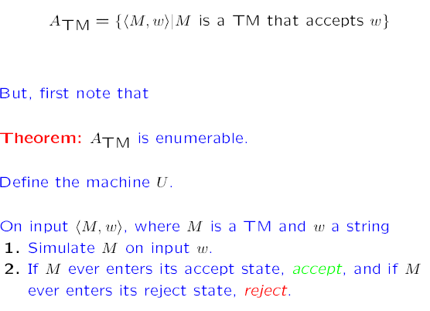

Slide 18
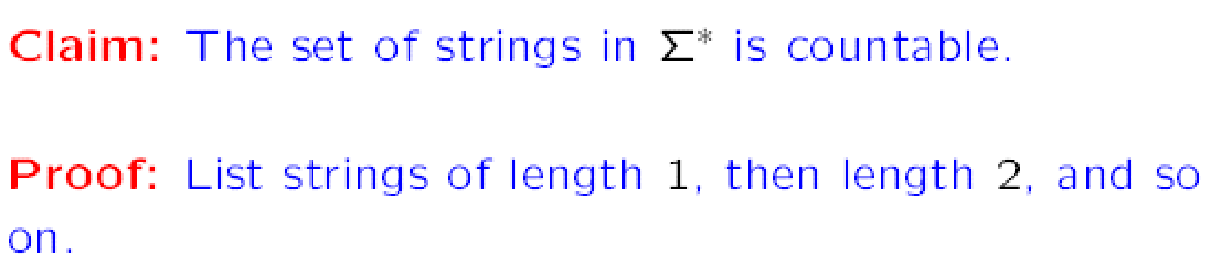
Turing Machines are countable

Slide 19
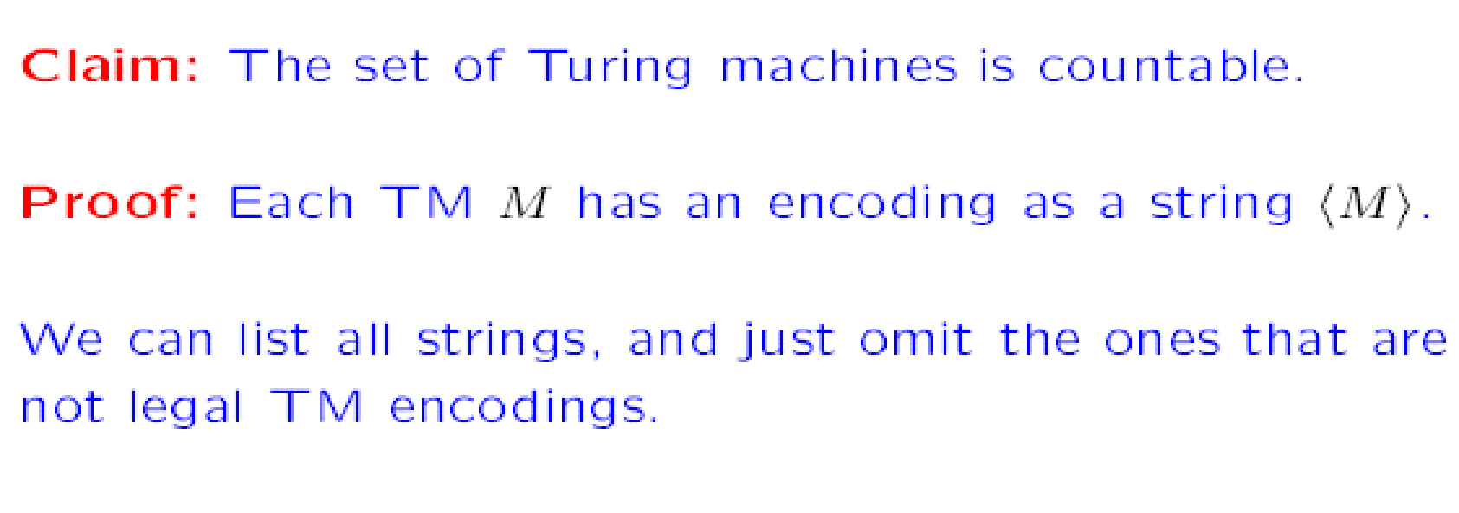

Slide 20
Turing machines and computability
Recap :
1. Deﬁnition of Turing machines: high level and low-level descriptions
2. Variants of Turing machines
3. Decidable and Turing recognizable languages
4. Church-Turing Hypothesis UNDECIDABILITY
5. Undecidability and a proof technique by diagonalization

Slide 21

Undecidable problems
is empty?
is regular?
has size 2?
This can be generalized to all non-trivial properties of Turing-acceptable languages

Slide 22
Rice’s theorem (1953)
Any non-trivial property of R.E languages is undecidable!
Property P ≡ set of languages satisfying P
Property of r.e languages: membership of M in P depends only on the language of M.
If L(M) = L(M ’), then <M> ∈ P if <M’> ∈ P
4. Non-trivial: It holds for some but not all TMs.

Slide 23
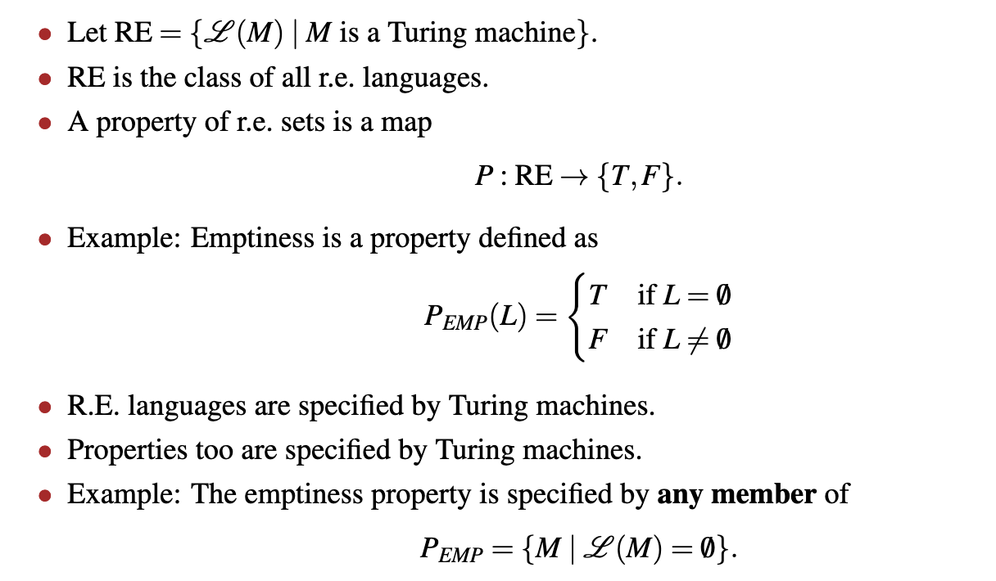
Properties of RE Languages

Slide 24
Property : Set of language
Just a subset of r.e. languages. Thus, L satisﬁes a property P if L ∈ P.
Examples:
Set of regular languages I
Set of context-free languages I
Set of all languages I
{∅} I
∅
So decidability of property P is decidability of language L P .

Slide 25
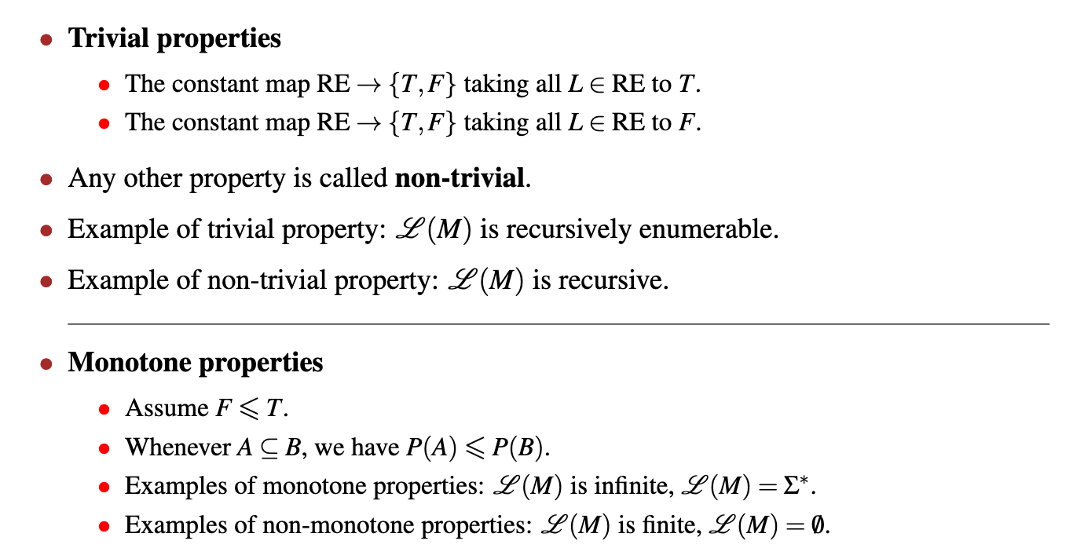
Type of Property

Slide 26
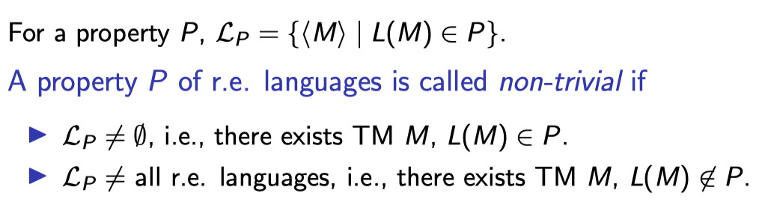
Non-trivial property

Slide 27

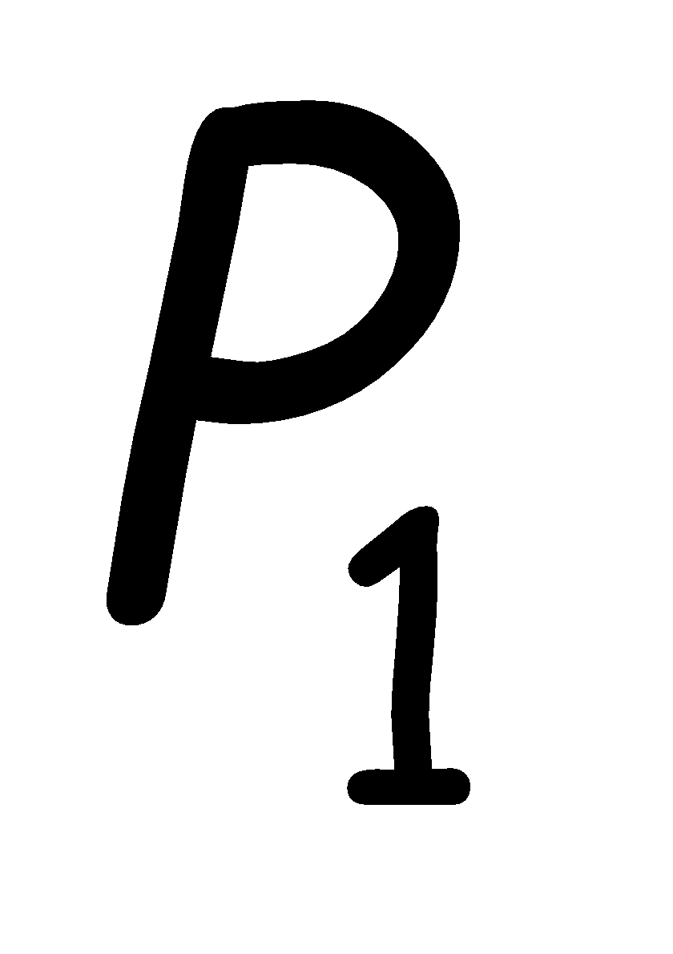

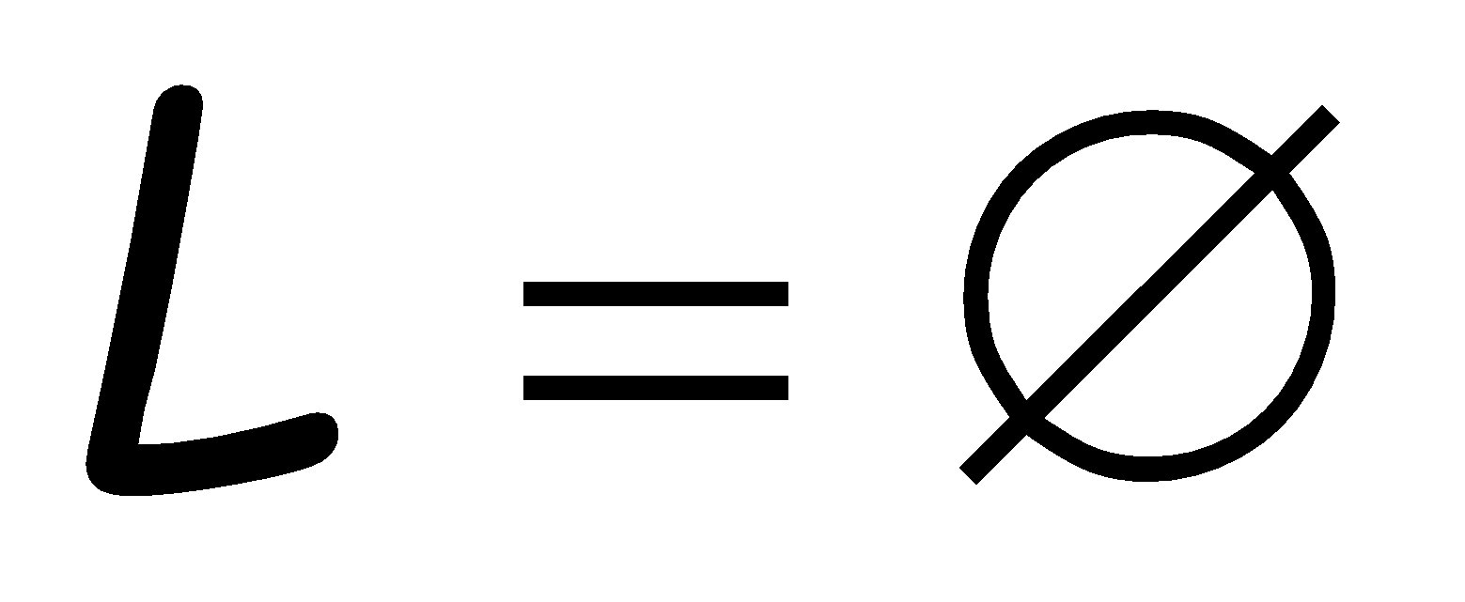
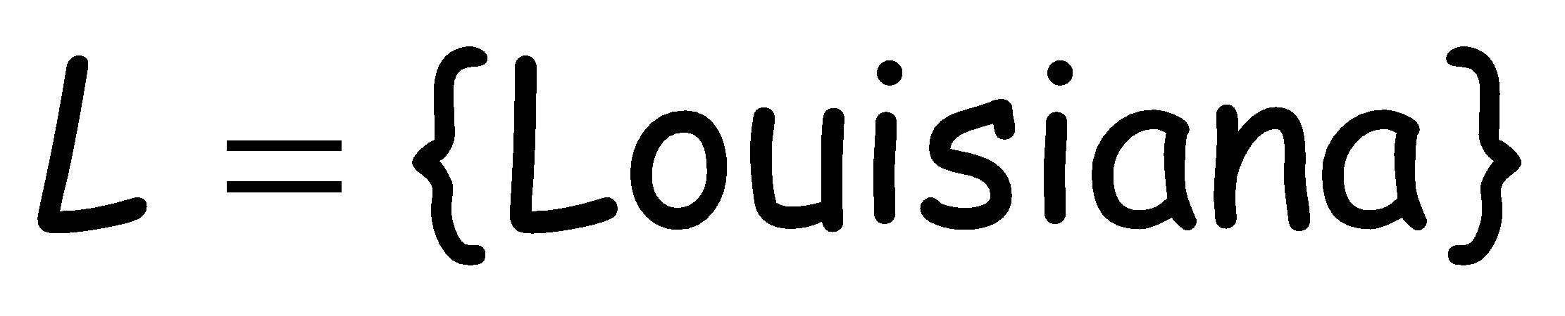
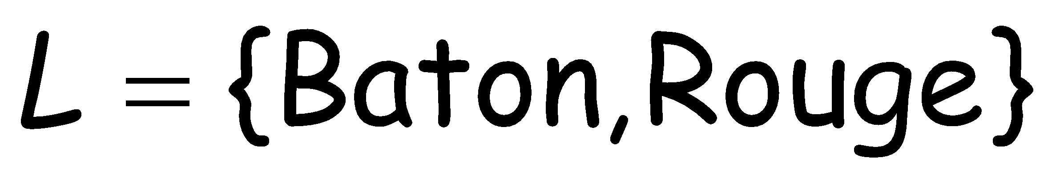
Non-trivial property:
A property possessed by some Turing-acceptable languages but not all
Example:
: is empty?
YES
NO
NO

Slide 28
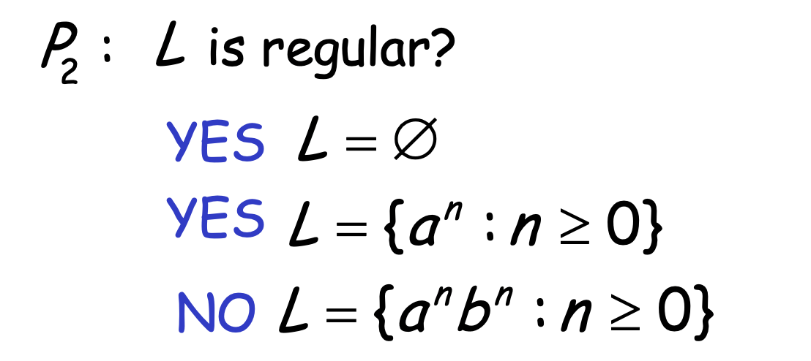
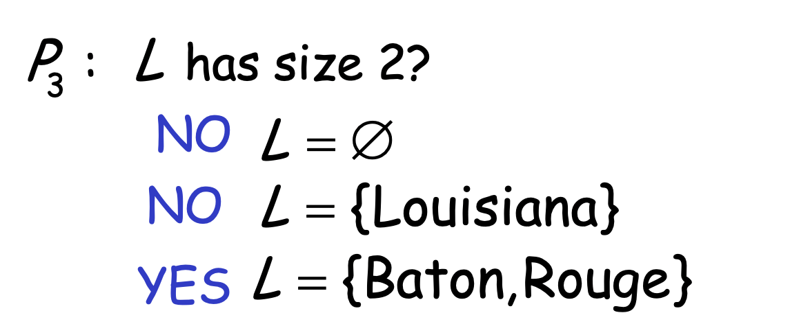
More examples of non-trivial properties

Slide 29
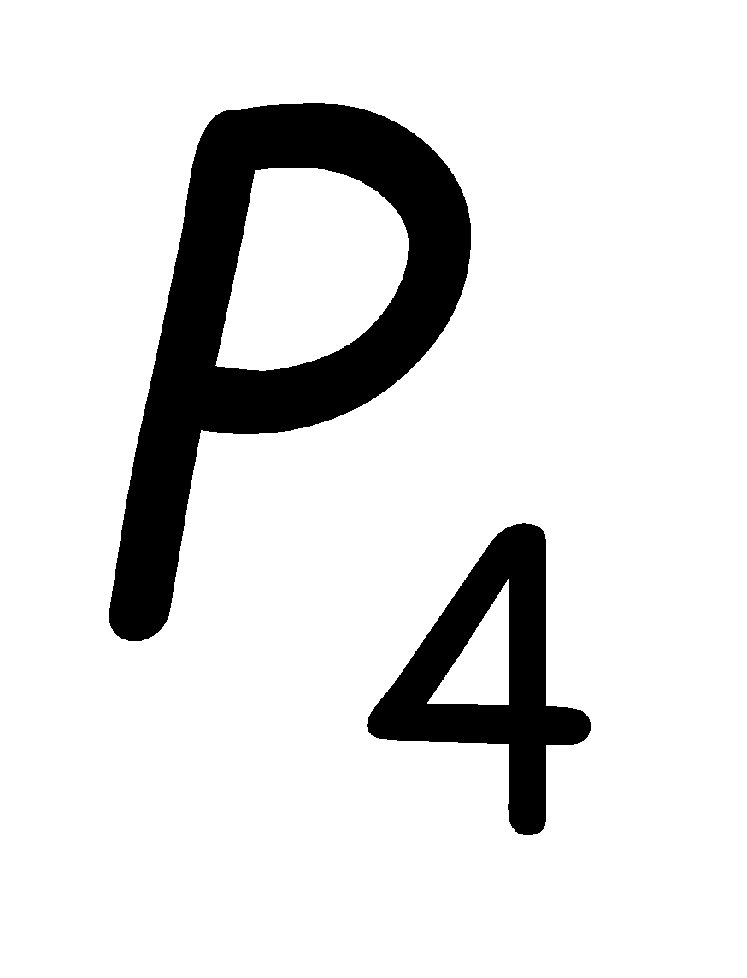
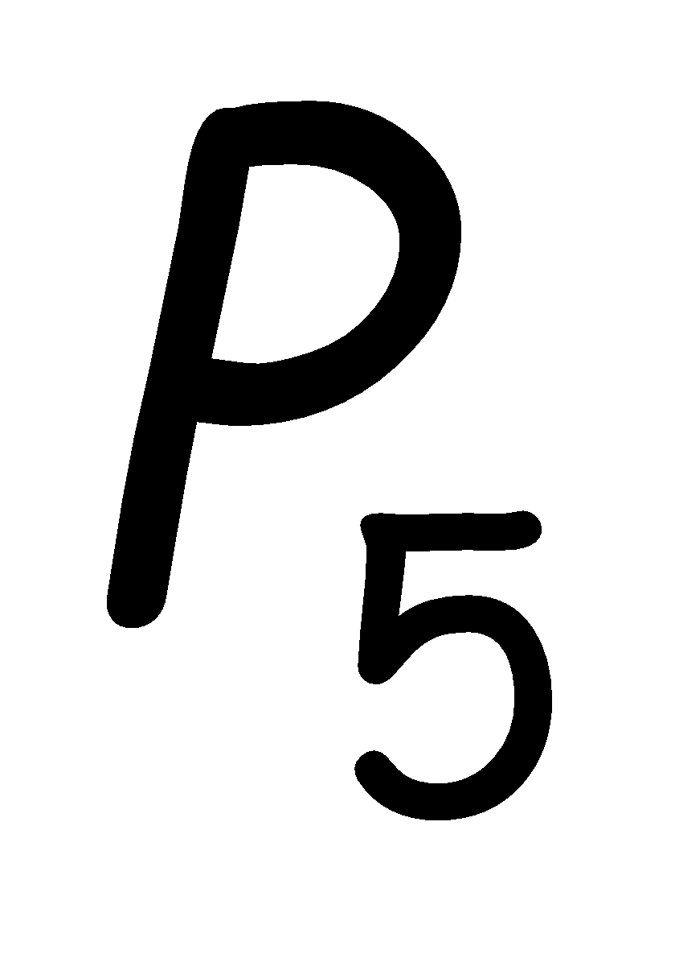
Trivial property:
A property possessed by ALL
Turing-acceptable languages
Examples:
: has size at least 0?
True for all languages
: is accepted by some
Turing machine?
True for all
Turing-acceptable languages

Slide 30


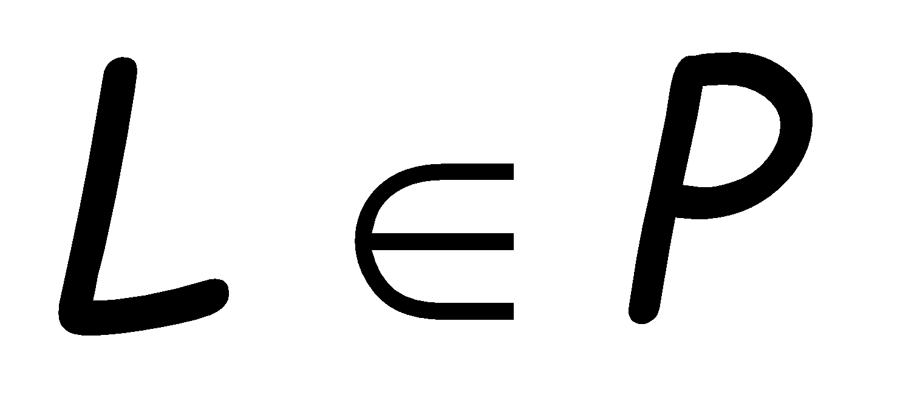
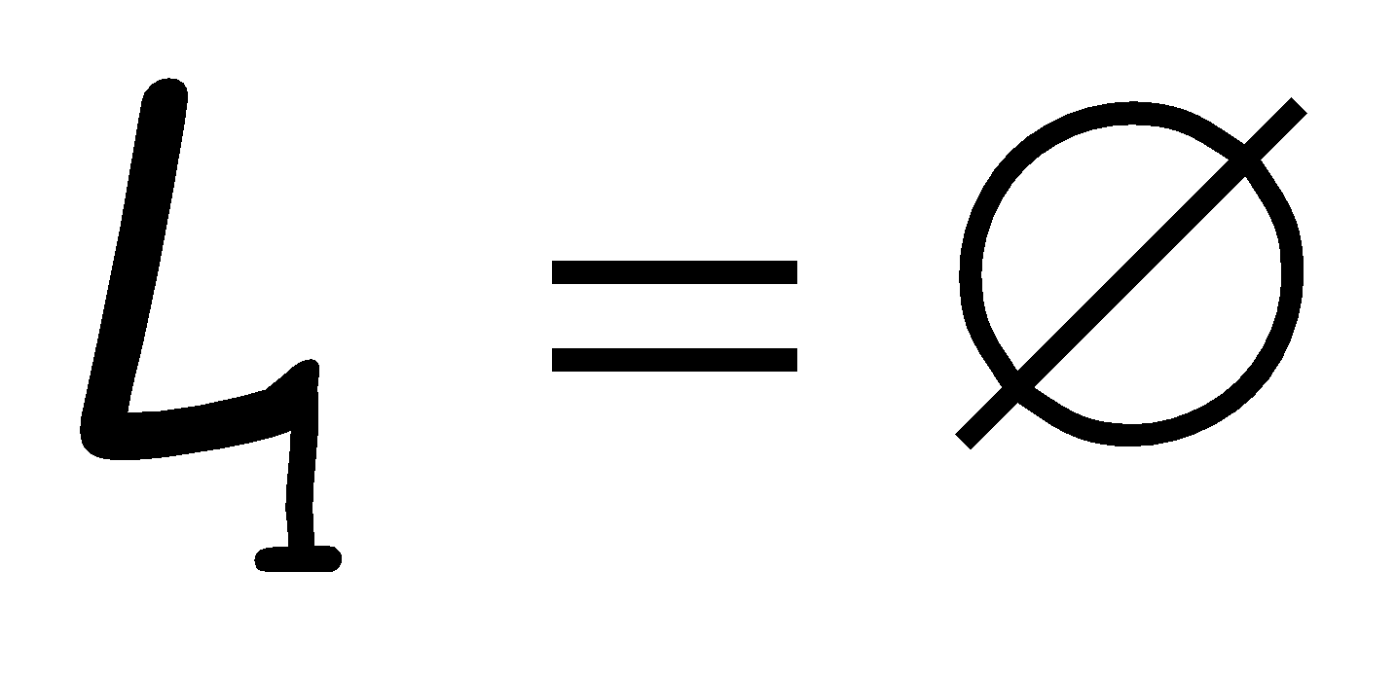
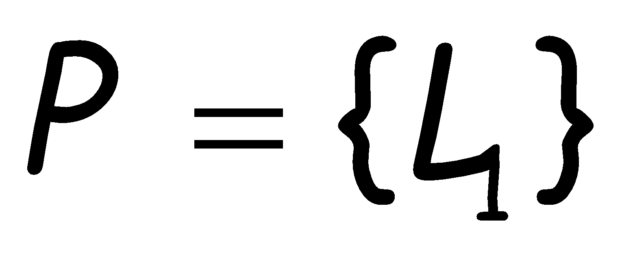
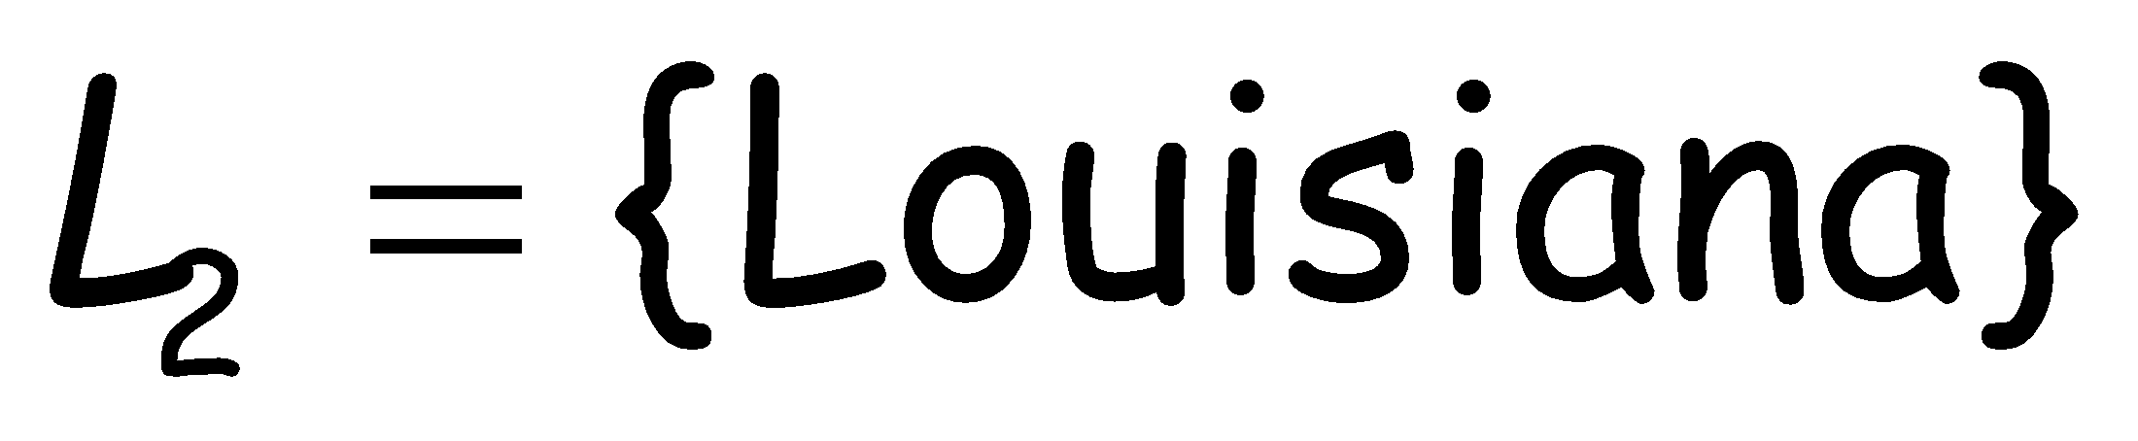
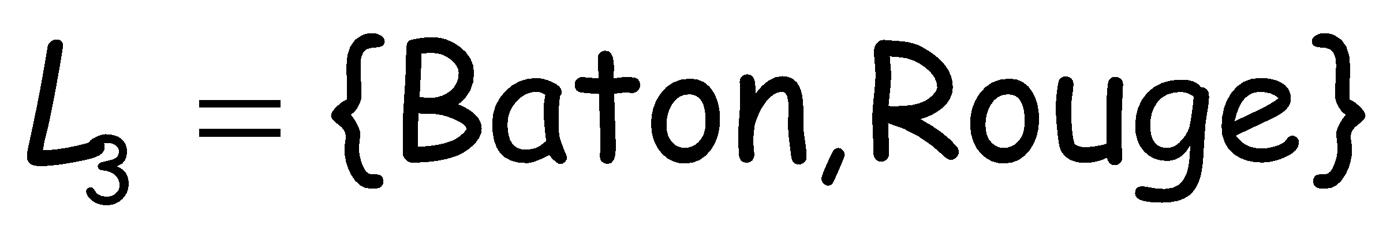
We can describe a property as the set
of languages that possess the property
If language has property then
Example:
: is empty?
YES
NO
NO

Slide 31
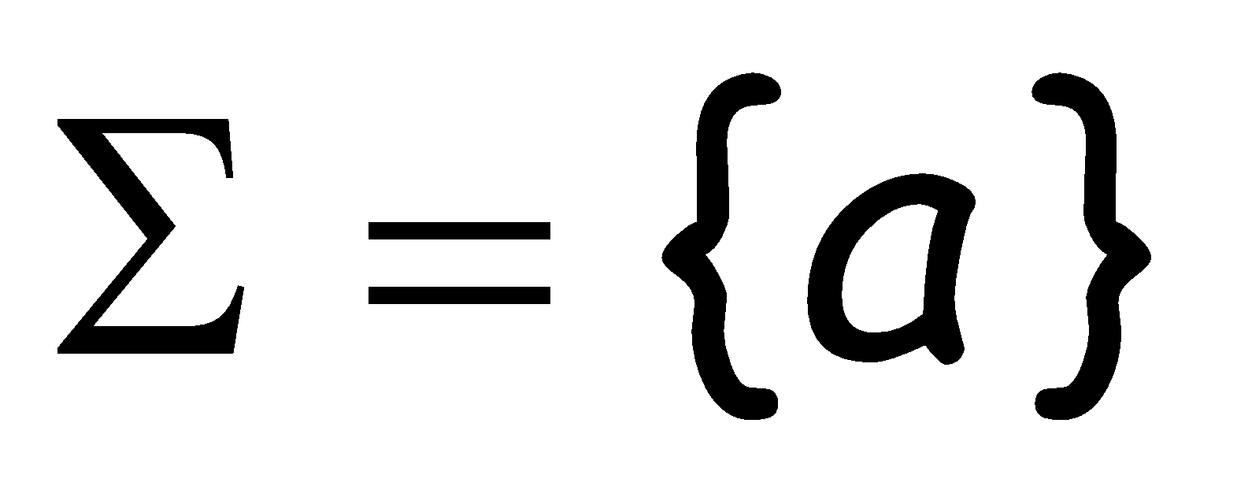

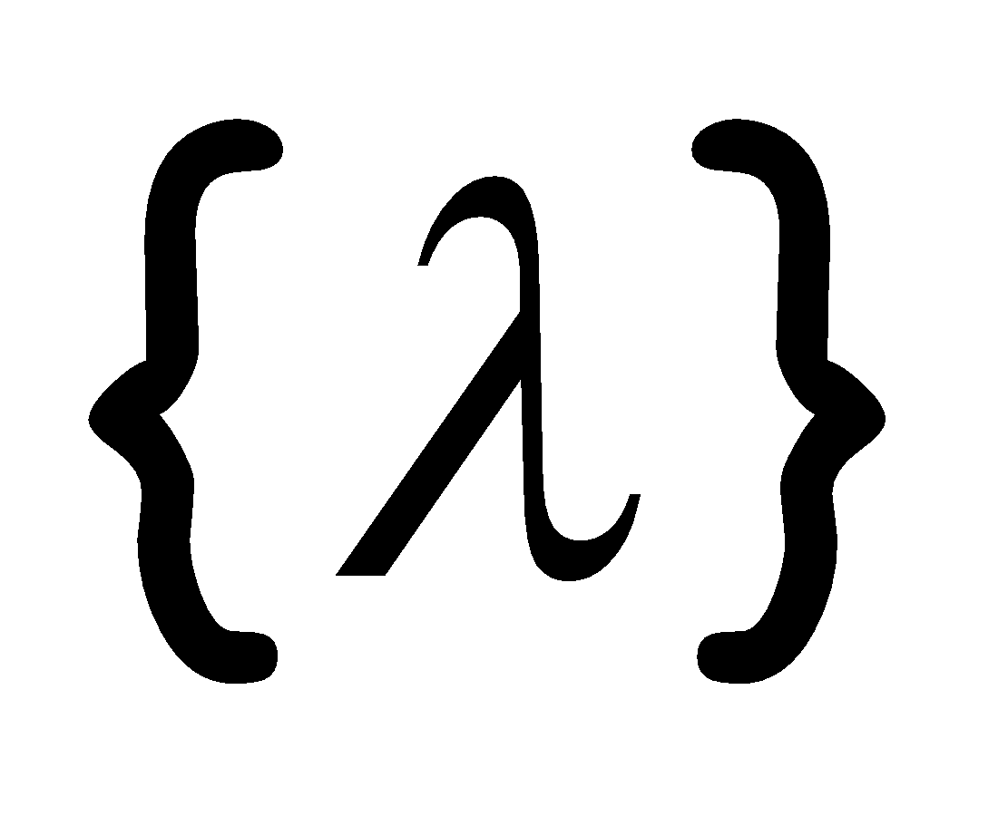
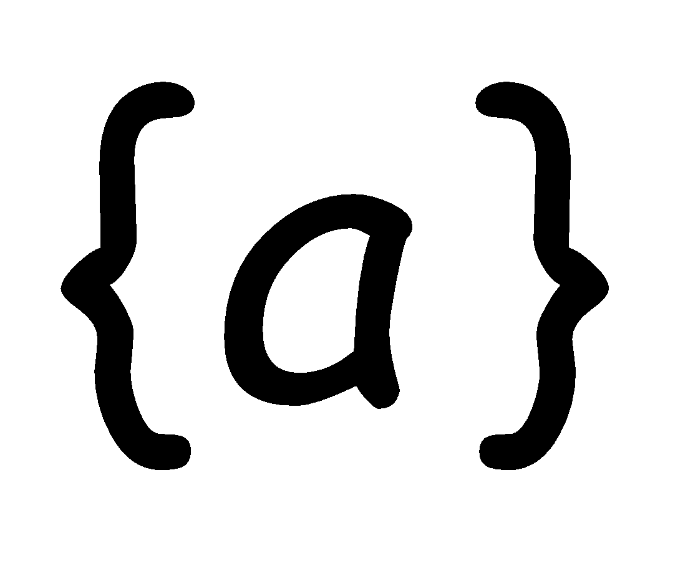
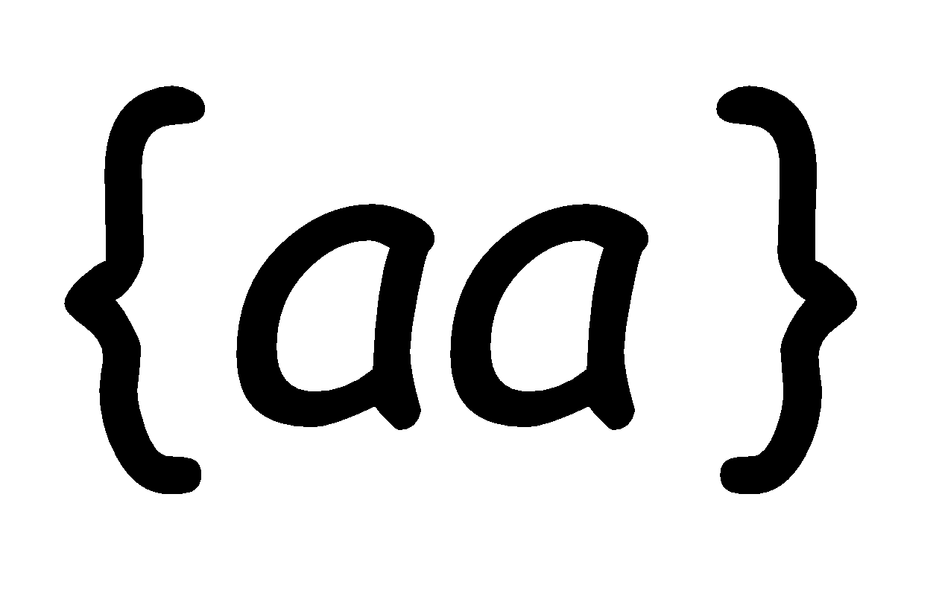
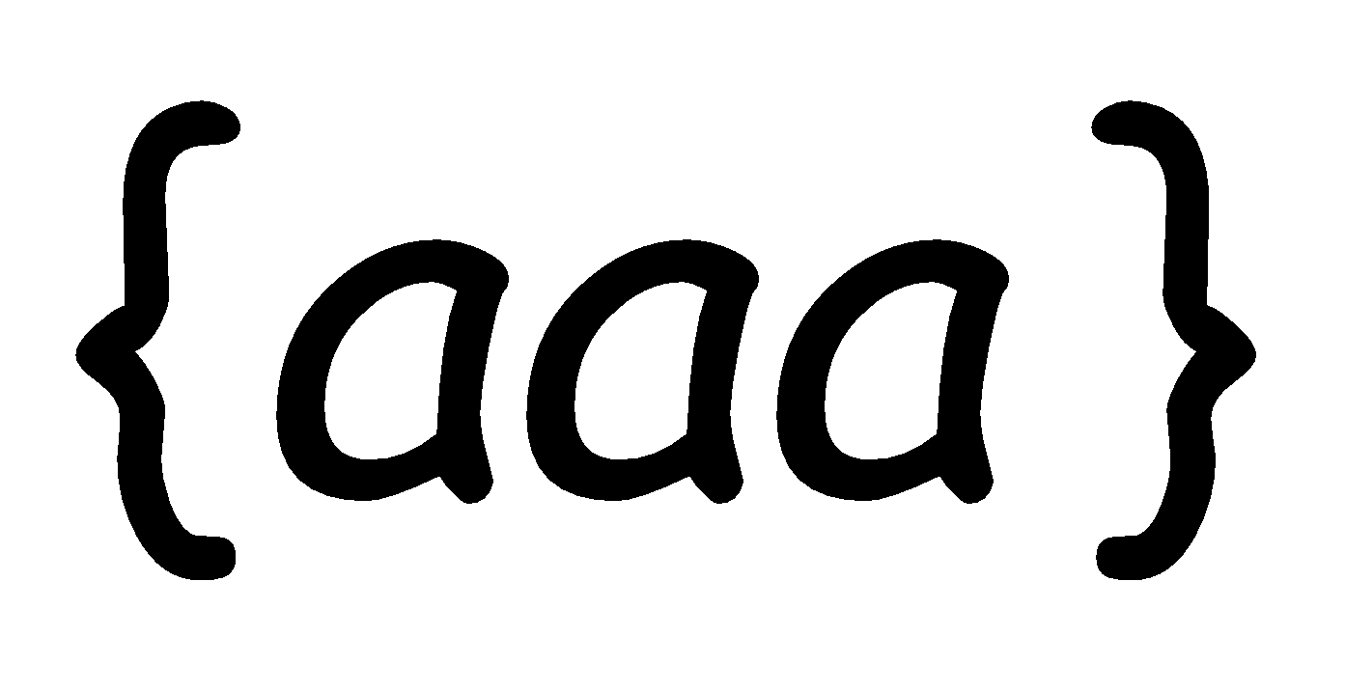

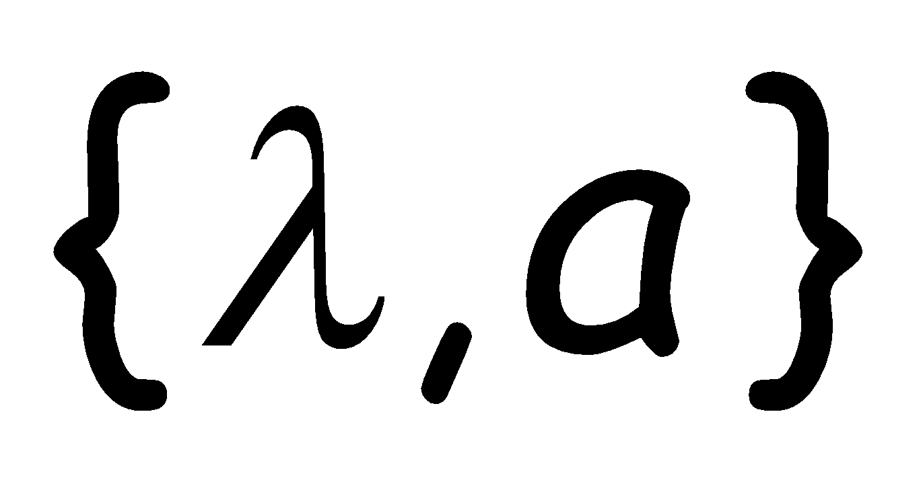
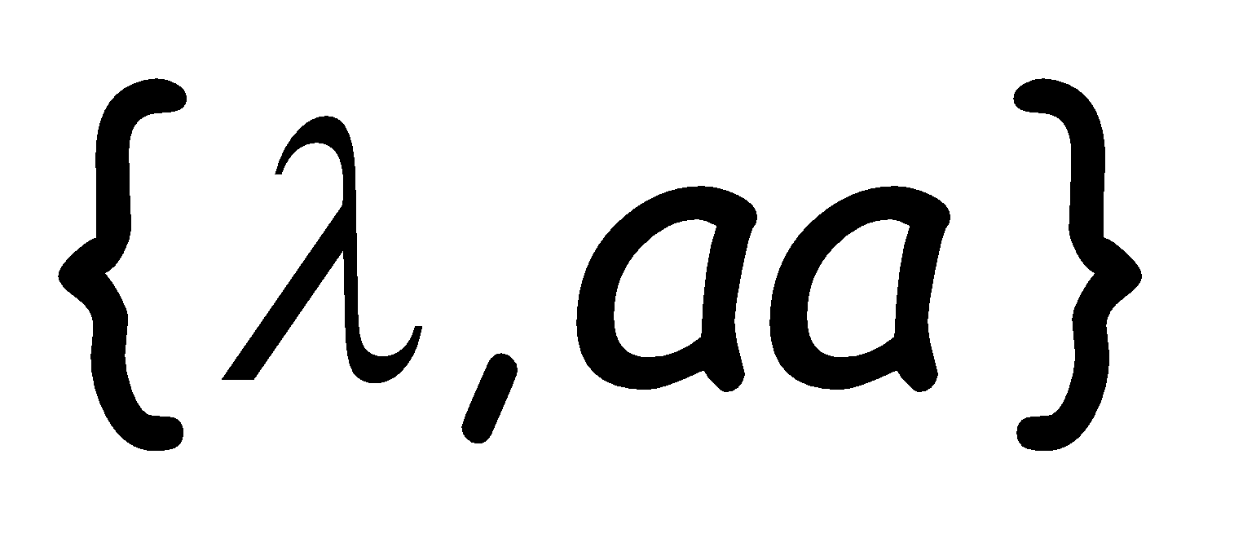
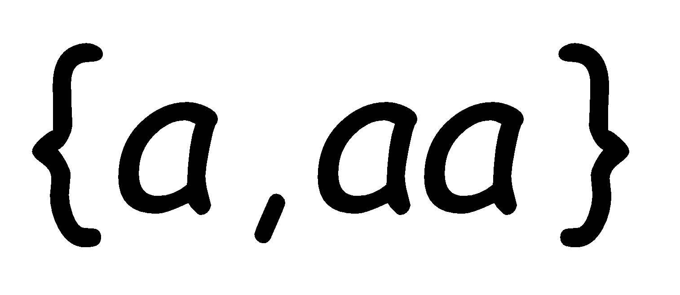
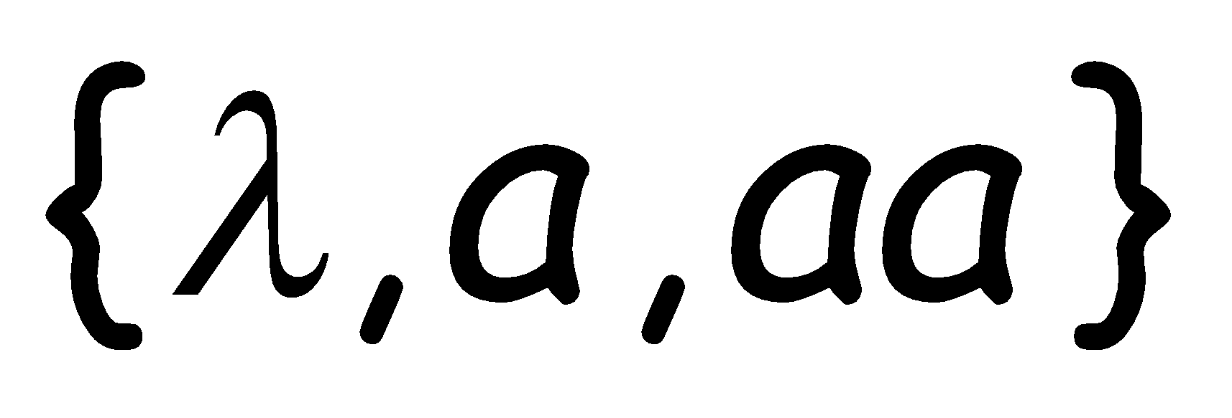
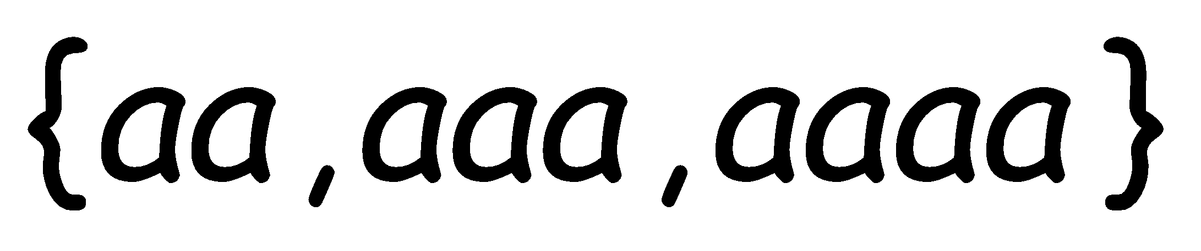
Example:
Suppose alphabet is
: has size 1?
NO
YES
NO
NO

Slide 32




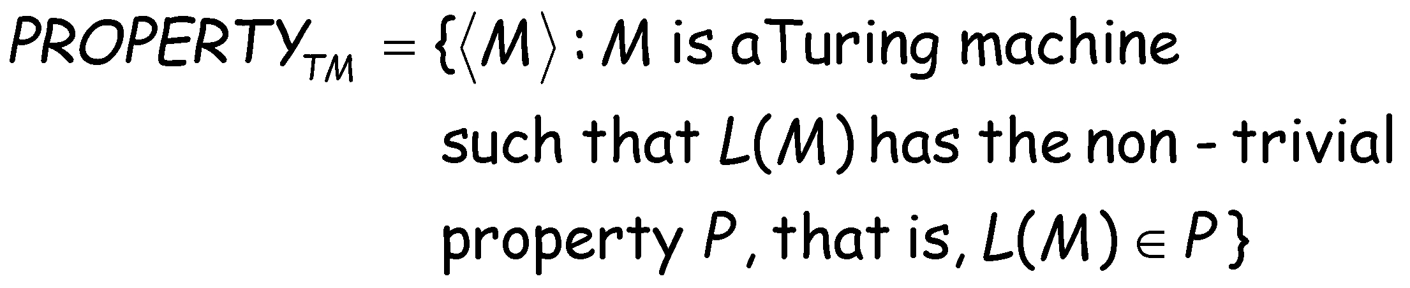
Non-trivial property problem
Input:
Turing Machine
Question:
Does have the non-trivial
property ?
Corresponding language:

Slide 33
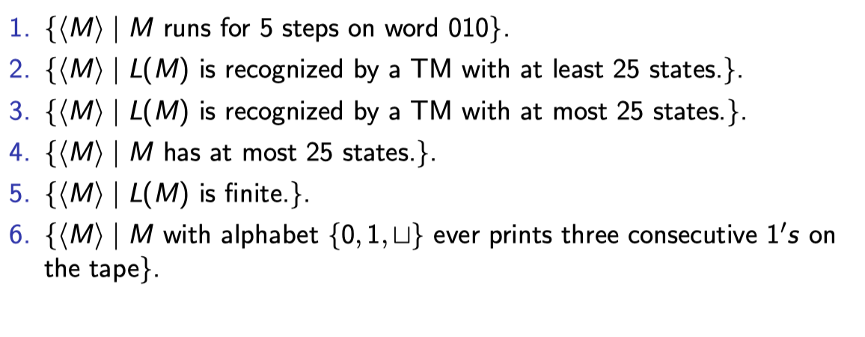
Can u apply rice theorem ?
For each of No answers above, is the language decidable?
What do you do when Rice’s theorem does not apply? Fall back on reductions!

Slide 34
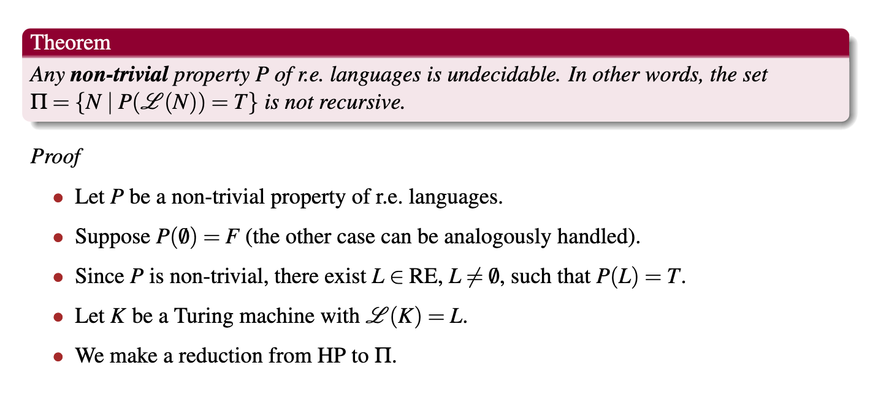
Rice Theorem ( Part 1 )

Slide 35
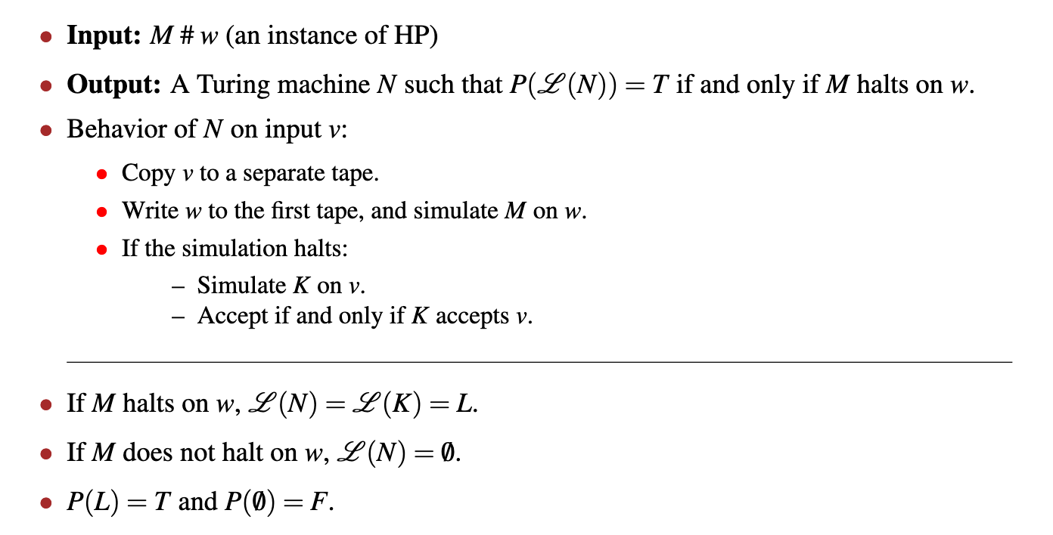
Rice Theorem – The reduction

Slide 36
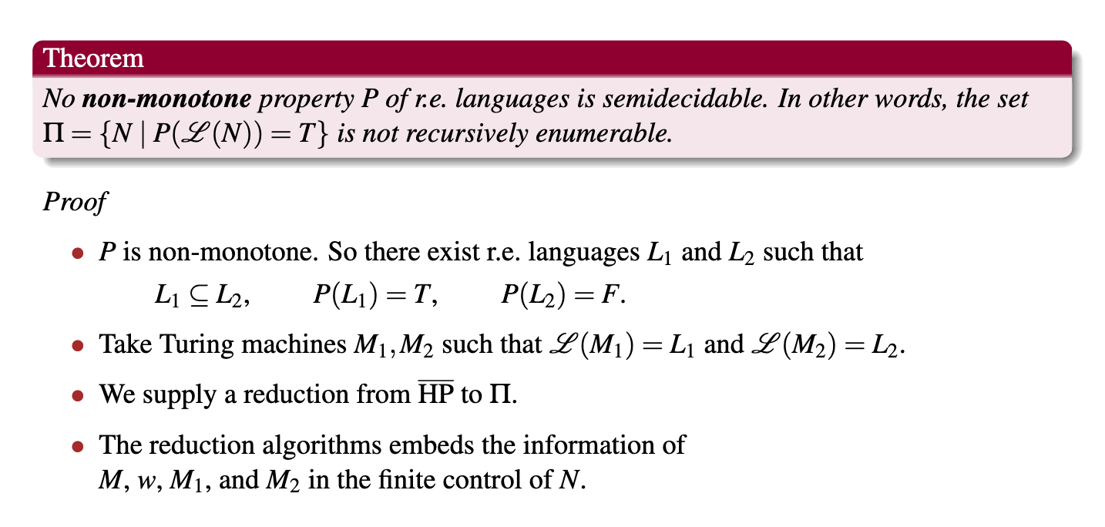
Rice Theorem ( Part 2 )

Slide 37
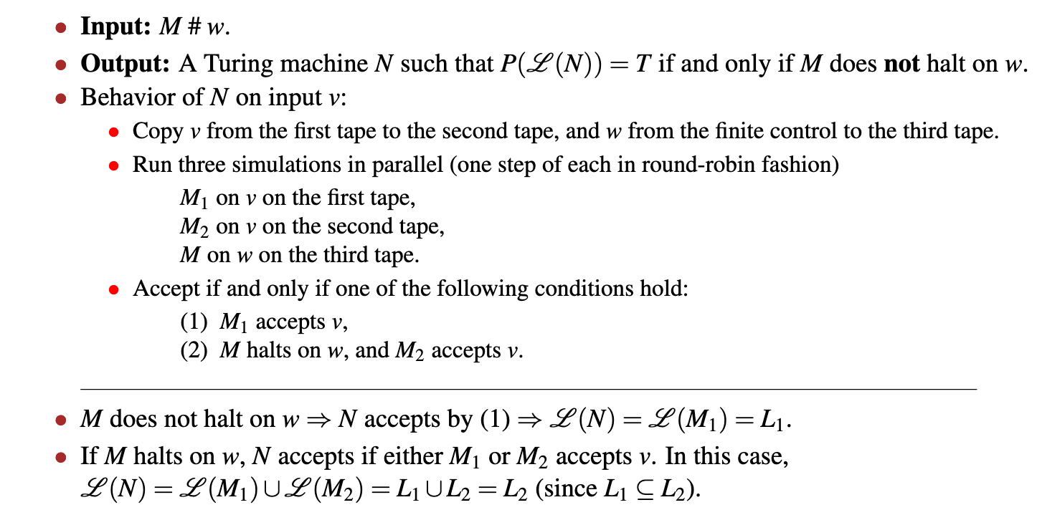
Rice Theorem (Part 2) – The reduction

Slide 38
POST’s CORRESPONDENCE PROBLEM

Slide 39
Post Correspondence Problem
The Post Correspondence Problem (PCP), introduced by Emil Post in 1946, is an undecidable decision problem.
The PCP problem over an alphabet ∑ is stated as follows −
Given the following two lists, M and N of non-empty strings over ∑ −
M = (x₁, x₂, x₃,………, x_{n})
N = (y₁, y₂, y₃,………, y_{n})
We can say that there is a Post Correspondence Solution, if for some i₁,i₂,………… i_{k}, where 1 ≤ i_{j} ≤ n, the condition x_{i1} …….x_{ik} = y_{i1} …….y_{ik} satisfies.

Slide 40
Example 1
Find whether the lists
M = (abb, aa, aaa) and N = (bba, aaa, aa)
have a Post Correspondence Solution?

Slide 41
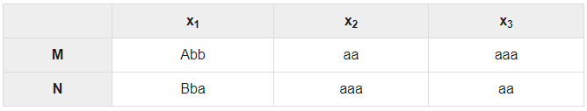
Solution for Example 1
Here,
x₂x₁x₃ = ‘aaabbaaa’
and y₂y₁y₃ = ‘aaabbaaa’
We can see that
x₂x₁x₃ = y₂y₁y₃
Hence, the solution is i = 2, j = 1, and k = 3.

Slide 42
Example 2
Find whether the lists M = (ab, bab, bbaaa) and N = (a, ba, bab) have a Post Correspondence Solution?

Slide 43
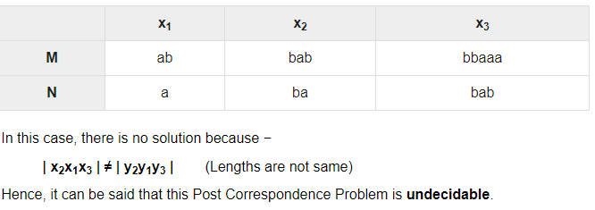
Solution for Example 2

Slide 44
•
General Objective:
to understand the concept of PCP
Specific Objectives
State the objective of PCP
Define PCP problem
Check whether the PCP instance have a solution or not.
Define MPCP
Illustrate the conversion of TM to MPCP with an example
•

Slide 45
Post Correspondence Problem
It involves with strings
Goal:
– To prove this problem about strings to be undecidable

Slide 46
Post Correspondence Problem
•
FORMAL DEFINITION
➢Given two lists of strings A and B ( equal length)
A = w₁, w₂, …, w_{k} B = x₁, x₂, …, x_{k}
The problem is to determine if there is a sequence of
one or more integers i₁, i₂, …, i_{m} such that:
w_{i1}w_{i2}…w_{im} = x_{i1}x_{i2}…x_{im}
(w_{i}, x_{i}) is called a corresponding pair.

Slide 47
Example
 | A | B
i | w_{i} | x_{i}
1 | 1 | 111
2 | 10111 | 10
3 | 10 | 0
This PCP instance has a solution: 2, 1, 1, 3: w₂w₁w₁w₃ = x₂x₁x₁x₃ = 101111110

Slide 48
Does this PCP instance have a solution?
 | A | B
i | w_{i} | x_{i}
1 | 110 | 110110
2 | 0011 | 00
3 | 0110 | 110
This PCP instance has a solution: 2,3,1 w2w3w1 = x2x3x1 = 00110110110
One more solution:
2,1,1,3,2,1,1,3

Slide 49
Modified Post Correspondence Problem (MPCP)
Definition:
➢first pair in the A and B lists must be the first pair in the solution, i.e., the problem is to determine if there is a sequence of zero or more integers i₁, i₂, …, i_{m} such that:
w₁w_{i1}w_{i2}…w_{im} = x₁x_{i1}x_{i2}…x_{im}

Slide 50
Modified Post Correspondence Problem (MPCP)
i | List A w_{i} | List B x_{i}
1 | 10 | 10
2 | 110 | 11
3 | 11 | 011
This MPCP instance has a solution: 1,2,3
w₁ w₂ w₃ = x₁ x₂ x₃
10 110 11 = 10 11 011

Slide 51
Undecidability of PCP
To show that PCP is undecidable, we will reduce the universal language problem (Lu) to MPCP and then to PCP:
Universal Language
A mapping
A mapping
MPCP
PCP
Problem (Lu )
If PCP can be solved, Lu can also be solved. Lu is undecidable, so PCP must also be undecidable.

Slide 52
Reducing MPCP to PCP
This can be done by inserting a special symbol (*) to the strings in list A and B of to make sure that the first pair will always go first in any solution.
List A : * follows the symbols of ∑
List B : * precedes the symbols of ∑
^{w}_{k+1} ^{= $ ; x}_{k+1} ^{= *$}

Slide 53
Mapping MPCP to PCP
Suppose the original MPCP instance is:
 | A | B
i | w_{i} | x_{i}
1 | 1 | 111
2 | 10111 | 10
3 | 10 | 0

Slide 54
Mapping MPCP to PCP
The mapped PCP instance will be:
A B
i | w_{i} | x_{i}
0 | *1* | *1*1*1
1 | 1* | *1*1*1
2 | 1*0*1*1*1* | *1*0
3 | 1*0* | *0
4 | $ | *$

Slide 55
Mapping Lu to MPCP
Turing machine M and an input w, we want to determine if M will accept w.
the mapped MPCP instance should have a solution if and only if M accepts w.

Slide 56
Mapping Lu to MPCP
Lu instance MPCP instance
Given: (T,w)
Two lists: A and B
Construct an MPCP instance
If T accepts w, the two lists can be matched. Otherwise, the two lists cannot be matched.

Slide 57
Rules of Reducing Lu to MPCP
We summarize the mapping as follows. Given T and w, there are five types of strings in list A and B:
Starting string (first pair):
List A List B
# #q₀w#
where q₀ is the starting state of T.

Slide 58
Strings for copying:
List A X
#
List B X
#
where X is any tape symbol (including the blank).
# is a separator can be appended to both the lists

Slide 59
Strings from the transition function δ: List AList B
qX | Yp | from δ(q,X)=(p,Y,R)
ZqX | pZY | from δ(q,X)=(p,Y,L)
q# | Yp# | from δ(q,#)=(p,Y,R)
Zq# pZY# from δ(q,#)=(p,Y,L)
where Z is any tape symbol except the blank.

Slide 60
Strings for consuming the tape symbols at the end:
List AList B
Xq qY XqY
q q q
where q is an accepting state, and each X and Y is any tape symbol except the blank.

Slide 61
Ending string:
List A q##
List B
#
where q is an accepting state.
Using this mapping, we can show that the original Lu instance has a solution if and only if the mapped MPCP instance has a solution.

Slide 62
PCP is undecidable
•
•
•
Theorm: Post’s Correspondence Problem is undecidable.
We have seen the reduction of MPCP to PCP
now we see how to reduce Lu to MPCP.
M accepts w if and only if the constructed MPCP instance has a solution.
As Lu is undecidable, MPCP is also undecidable.

Slide 63
Recursive and Recursively Enumerable Language - Properties

Slide 64
Recursive Enumerable (RE) or Type -0 Language
RE languages or type-0 languages are generated by type-0 grammars.
An RE language can be accepted or recognized by Turing machine which means it will enter into final state for the strings of language
May or may not enter into rejecting state for the strings which are not part of the language.
It means TM can loop forever for the strings which are not a part of the language.
RE languages are also called as Turing recognizable languages.

Slide 65
Recursive Enumerable (RE) or Type -0 Language
RE languages or type-0 languages are generated by type-0 grammars.
An RE language can be accepted or recognized by Turing machine which means it will enter into final state for the strings of language
May or may not enter into rejecting state for the strings which are not part of the language.
It means TM can loop forever for the strings which are not a part of the language.
RE languages are also called as Turing recognizable languages.

Slide 66
Recursive Language (REC)
A recursive language (subset of RE)
Decided by Turing machine
It will enter into final state for the strings of language and rejecting state for the strings which are not part of the language.
e.g.; L= {a^{n}b^{n}c^{n}|n>=1} is recursive because we can construct a turing machine which will move to final state if the string is of the form a^{n}b^{n}c^{n}
else move to non-final state.
So the TM will always halt in this case.
REC languages are also called as Turing decidable languages.

Slide 67
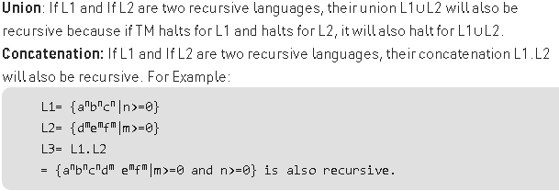
Closure Properties of Recursive Languages

Slide 68


Slide 69
Introduction to Computational Complexity

Slide 70
Computational Problems that can be modelled and solved by computer
Complexity how much of some resource (time, space) a problem takes up when being solved

Slide 71
The amount of resources required for executing a particular (computation or) algorithm is the computational complexity of that algorithm.
In general, when we talk about complexity we are talking about time complexity and space complexity.

Slide 72
Turing Machines - the Role
Basic tool for complexity theory.
An abstract model of computation machine: conceptually simple .
can execute any computation possible on “known computers”
resources consumption models well “real” computers

Slide 73
TIME COMPLEXITY-Turing Machine
How long computation takes to execute
For a Turing machine, the time complexity refers to the measure of the number of times the tape moves when the machine is initialized for some input symbols.
i.e Number of machine cycles

Slide 74
Time complexity of Turing Machine M on an input word w, denoted as T(M,w) is the number of steps done by the machine before it halts. If it does not, we set T(M,w) = ∞
We can also define time complexity of a machine itself as follows:
Function f : N → N is time complexity of M iff ∀n∈N :
f (n) = max{T(M,w) : w ∈ Σ n} (assuming it halts)

Slide 75
SPACE COMPLEXITY-Turing Machine
How much storage is required for computation.
In Turing machine It is number of cells used.
No. of bytes used

Slide 76
Space used by TM M on input word w, denoted as S(M,w) is defined as the number of tape cells that were visited by the head before M halted.
If M does not halt, it is not defined. We say that f : N → N is space complexity of M (with stop property) iff ∀n∈N : f (n) = max{S(M,w) : w ∈ Σ n}

Slide 77
EXAMPLE
0 | 0 | 0 | 1 | 1 | 1
Length n
Time complexity
x€0^{n}1^{n}
Each scan takes n Steps
The overall running time is O(n²)
Optimal solution for one tape Turing Machine O(nlogn)

Slide 78
EXAMPLE
Read only Tape
0 | 0 | 0 | 1 | 1 | 1
Length n
Space complexity
x€0^{n}1^{n}
Make the input tape as read only tape
How much space it require for computation?
If it uses tape as a stack it requires O(n) cells
Add Binary counter logic to the TM so If n=64,it takes log2(n)=7 bits in binary to keep the count
So we can solve it using O(logn) space.

Slide 79

NP HARD AND NP COMPLETE
-

Slide 80
P and NP problems
P:P problems refer to problems where an algorithm would take a polynomial amount of time to solve, or where Big-O is a polynomial (i.e. O(1), O(n), O(n²), etc).
These are problems that would be considered ‘easy’ to solve, and thus do not generally have immense run times.
Examples:
a. Linear Search
b. Binary Search
c. Merge Sort
d. Quick sort etc.,

Slide 81

P and NP problems
Can you guess the approximate time complexity of the given problem.

Slide 82
NP-Hard and Complete-Need
Np Hard and complete problems gives a base for a research topics.
Most of the algorithms are categorized into polynomial time (linear time), exponential time (2^n)algorithms.
Reason for looking other algorithms when we already have an algorithm
Reducing the run time is the major challenge!
Improve Efficiency until we have constant time Algorithm ie.O(1)

Slide 83
Polynomial Vs Exponential Algorithms
Polynomial Algorithms | Exponential Algorithms
Linear Search - n | 0/1 Knapsack Problem -2^{n}
Binary Search -log n | Travelling Salesman Problem-2^{n}
Insertion sort -n ² | Sum of Subsets-2^{n}
Merge Sort -n log n | Hamiltonian cycle-2^{n}
Exponential Algorithms are much more time consuming than Polynomial Algorithms. The framework for converting Exponential to Polynomial Algorithms is called NP Hard and Np Complete problems.

Slide 84
P and NP problems
Non deterministic Polynomial time solving.
Problem which can't be solved in polynomial time like TSP( travelling salesman problem)
An easy example of this is subset sum: given a set of numbers, does there exist a subset whose sum is zero?.
but NP problems are checkable in polynomial time means that given a solution of a problem , we can check that whether the solution is correct or not in polynomial time.

Slide 85
NP and P Problems
P -Deterministic polynomial time Algorithms
NP-Non Deterministic Polynomial Algorithms
For eg.Merge Sort from Non deterministic to Deterministic Algorithm
NP
P

Slide 86
NP Hard and NP Complete
Before knowing about NP-Hard and NP-Complete we need to know about reducibility:
Reduction:
Consider there are two problems, A and B, and we know that the problem A is NP class problem and problem B is a P class problem.
If problem A can be reduced, or converted to problem B, and this reduction takes a polynomial amount of time, then we can say that A is also a P class problem (A is reducible to B).

Slide 87
NP Hard and NP Complete
A problem is classified as NP-Hard when an algorithm for solving it can be translated to solve any NP problem.
Then we can say, this problem is at least as hard as any NP problem, but it could be much harder or more complex.
NP-Complete problems are problems that live in both the NP and NP-Hard classes.
This means that NP-Complete problems can be verified in polynomial time and that any NP problem can be reduced to this problem in polynomial time.

Slide 88
How to convert Exponential Algorithms to Polynomial Algorithms?
This can be done in two ways
By finding Deterministic and Non Deterministic Polynomial Algorithms
Deterministic –finite solution for every run of the program
Non Deterministic-random solution for every run of the program(every state has n number of possible next states)
Or
By solving a base problem(which includes all Exponential problems)by finding out the relationship among them

Slide 89
Non Deterministic Algorithm(Magic into procedure in future)
Problem Statement : Search an element x on A[1:n] where n>=1, on successful search return j if a[j] is equals to x otherwise return 0.
Non-deterministic Algorithm for this problem :
1.j= choice(a, n)------------------------O(1)
2.if(A[j]==x) then
{
write(j);
success();-----------------------------O(1)
}
3.write(0);
failure();------------------------------------O(1)
Non Deterministic Methods
choice(X) : chooses any value randomly from the set X.
failure() : denotes the unsuccessful solution.
success() : Solution is successful and current thread terminates.
Notes:
This algorithm can be used for research work so that in future this non deterministic parts can be converted into deterministic polynomial Algorithms
Choice might be obtained in constant time in future they may figure out a better algorithm for it.
This Non Deterministic Algorithm may become a Deterministic Algorithm in future

Slide 90
Satisfiability Problem(SAT)
Definition. A formula A is satisfiable if there exists an assignment of values to its variables that makes A true.
A=(¬x ∨ y) ∧(~y V z)^(x V ~z V y)-Three variables hence we have 2³ input so this is similar to other exponential Algorithms It take values from 000 to 111 (different combination of binary input for each variable x,y,z) We have to try 8 values ie.2^{3.} For n variables it will be 2^{n} State space tree x=1 x=0 y=1 y=0 1 0
z=1 0 1 0 1 0 1 0
If this problem is solved all other exponential algorithms can be solved in polynomial time!

Slide 91
Np Hard-Reduction
SAT is a Np-Hard Problem
SAT 0/1 Knapsack Problem(Reduction!)
Then 0/1 knapsack is also a NP Hard Problem if the reduction is in polynomial time
SAT L1,then L1 is also Np-Hard
SAT L1,L1 L2 then L2 is also NP Hard hence transitive property holds true.

Slide 92

Np Complete
If a problem comes under Np Hard and if it has a non deterministic algorithm then it is also called as a Np Complete problem
SAT L Non Deterministic NP Complete Problem
Notes:
Here SAT is a NP Complete problem since it has Non Deterministic Algorithm

Slide 93
Cook’s Theorem
Cook’s Theorem states that
Any NP problem can be converted to SAT in polynomial time
SAT will come into P if and only if P=NP, it will become deterministic.

Slide 94


Clique to Vertex Cover

Slide 95
Summary
Polynomial and Exponential Algorithms
Framework/Guidelines for working on Exponential Algorithms
NP-Hard
Np-Complete
Cook’s Theorem
Hope all our Non Deterministic Algorithms will turn into Polynomial Deterministic Algorithm i.e.P=NP☺

